Slide 1
Indigenous Activism:
The Paradox of Colonial Mass Media’s Propaganda and Censorship

Slide 2
Impacts of Capitalism, Assimilation & Colonialism to Indigenous Peoples:
Before the day is over an Indigenous persons homeland will be clear-cut, strip-mined or flooded by a dam.
Before the week is over an Indigenous person will be killed or displaced, because of economic interest.
Every two weeks an Indigenous language is lost: Most impacted regions are Northern Mexico, United States and Canada.
Poverty, Unemployment and Hunger are highest in Indigenous communities: Hunger is not because of lack of food but for the lack of land for crops and access to water. (O’otham and Guatemala)
  Source: unitednations/unpfii.org. gric.org.

Slide 3
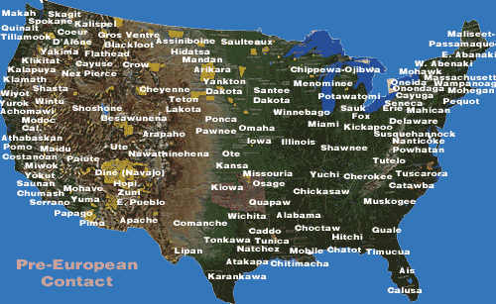

Slide 4
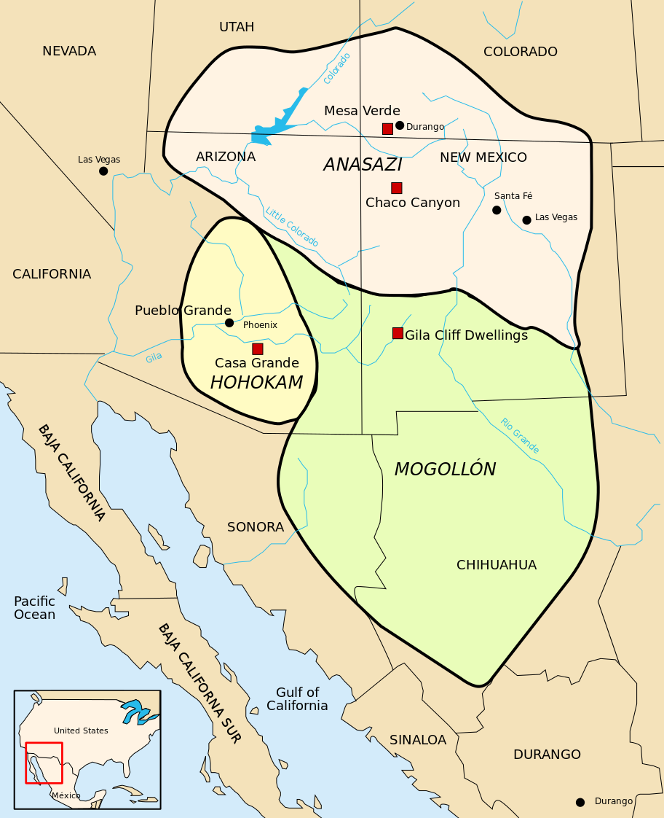
Southwest United Sates:

Slide 5
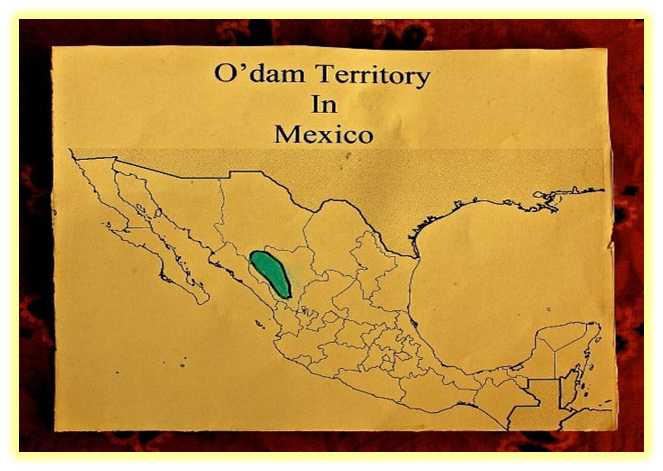
Hahajun (Relatives) in Northern Mexico:

Slide 6
Reservation Poverty (Sustained)
Residents with income below poverty level:
  GRIC 47% (2000)
  Arizona 10% (2000)
  75% Reservations in Arizona (2009)
  21% State of Arizona (2009)

Slide 7
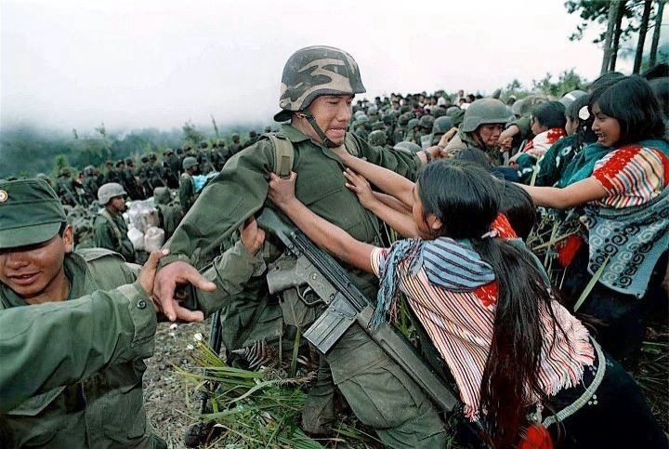
Roots of Resistance: Chiapas 1992

Slide 8
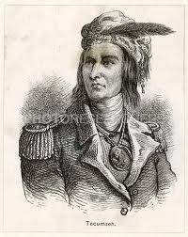
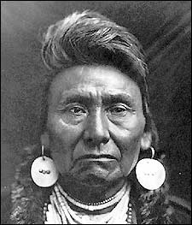
Tecumseh-Shawnee (1768-1813)
Him-mah-too-yah-lat-kekt- Nez Perce (1840-1904)

Slide 9
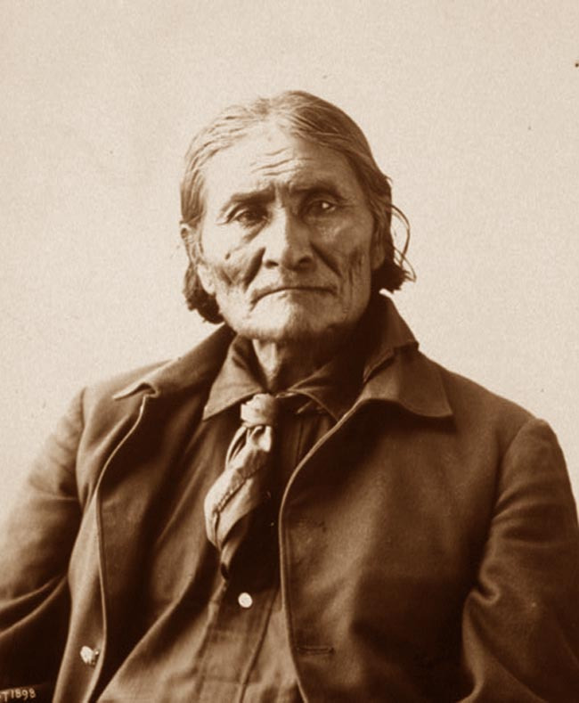
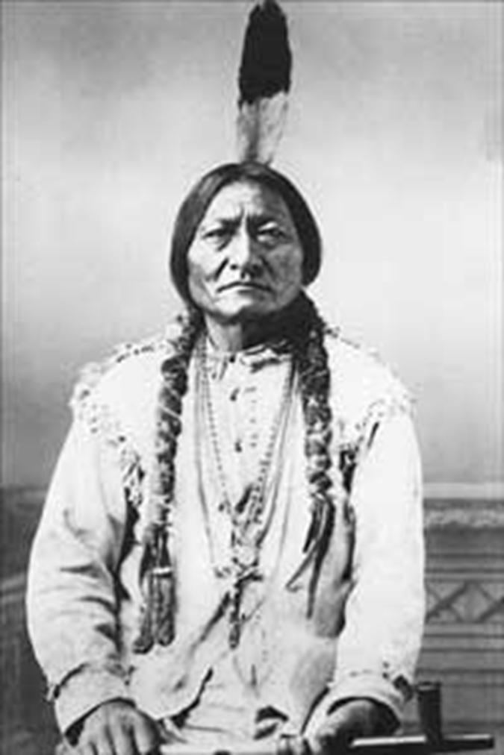
Goyathlay - Chiricahua (1829-1909
Tatanka-Iyotanka – Hunkpapa (1831-1890)

Slide 10
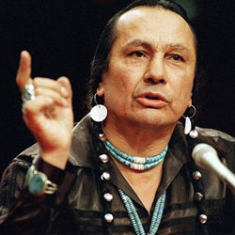
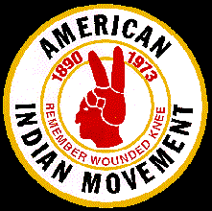
Russell Means – Oglala (1939-October 2012)

Slide 11
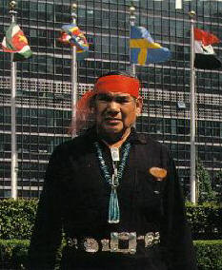
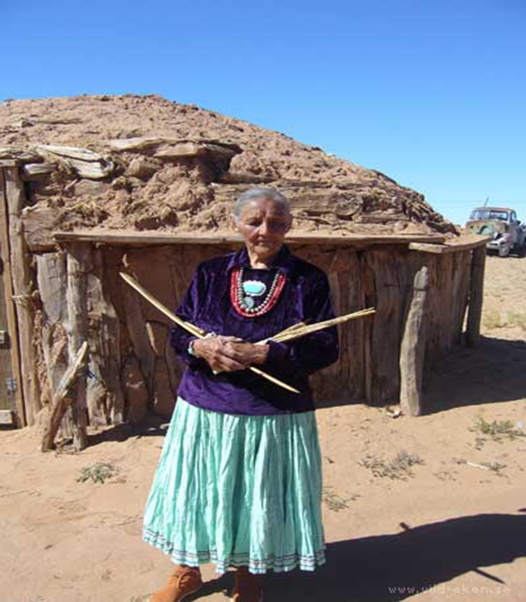
Thomas B. House of Mica – Hopi
Pauline whitesinger – Din’e (big mountain)

Slide 12
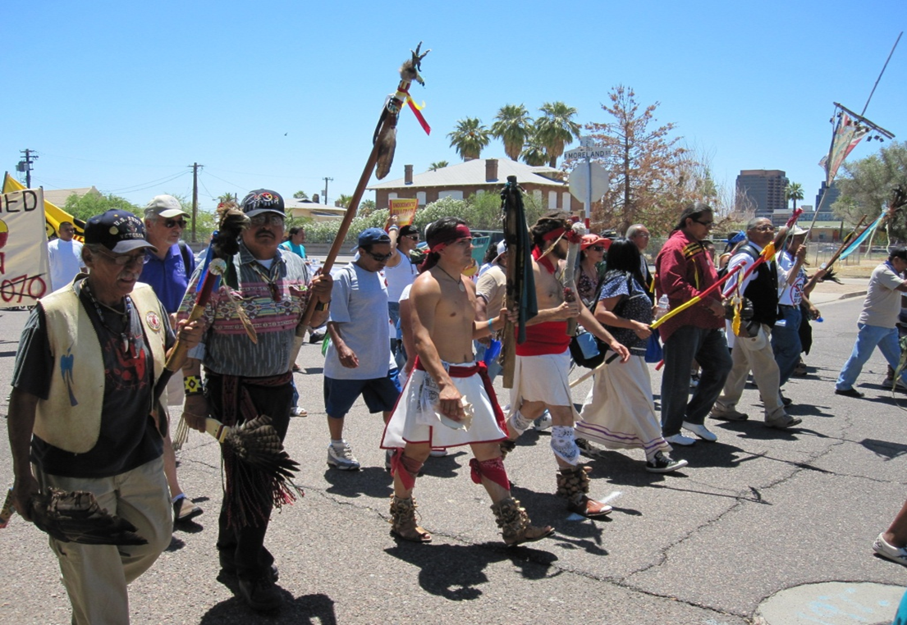
Immigration SB1070 (Arizona -2008)

Slide 13
American Mass Media Monopoly
There are about five private major and four minor mass media companies that define what all Americans read, listen, and watch.
  This means, these companies have an ordinate concentration of political, cultural, and educational power over most Americans
  American mass media companies receive most of the their revenue from advertisers. Advertisers want safe advertising spaces. As a result, American mass media companies broadcast stories in general that do not offend advertisers. Indigenous activism issues related to advertisers would never be covered positively because this would result in unsafe advertising spaces.
  American mass media companies concentration and conglomeration make it nearly impossible for Indigenous activism to be covered, and to be covered within a rich, dynamic, and honest perspective.
  American mass media companies production of films, cable and television programs tend to reinforce stereotypes about Indigenous peoples. As a result, makes Indigenous activism more problematic to be covered due to audiences lack of information and understanding about Indigenous people and their relationship to Indigenous peoples.

Slide 14
American Mass Media
ABC is owned by the Walt Disney Corporation. 2014 revenues: $48.213 billion; 2008 revenues were $37.8 billion
CW is joint-venture between CBS and Time-Warner. CBS Corporation’s 2013 Revenues: $15.284, Time-Warner’s Entertainment Co.: 2012 revenues: $12.526 billion. Time Warner Revenues: 2013, $29.795 billion; 2011 revenues: $28.974 billion; 2009 revenues: $25.8 Billion
News Corporation, a spin of of 21st Century Fox. 2012 revenues were $33.706 billion; 2009 revenues: $30.4 billion
NBC is owned by NBC Universal (100% by Comcast); 2013 Revenues: $23,650 billion; 2011 revenues: $21.4 Billion; Comcast is also the largest cable and residential ISP provider.
CBS/Viacom’s: CBS Corporation’s 2013 Revenues: $15.284; 2012 revenues: $14. 289 Billion; Viacom 2013 revenues: $13.78 Billion –

Slide 15
American mass media performance of Indigenous Issues is problematic:
American mass media frequently misrepresents issues
  Indigenous issues reported on never have a backstory (no comprehensive context).
  Indigenous issues and people are often portrayed as disrupting Americans.
  Indigenous issues and activism are never contextualized in stories as human rights, constitutional, or treaty rights issues.
  Indigenous issues and activism are never framed as colonial responses to U.S. government or corporate forms of oppression and human rights abuses.
  The American mass media never mentions treaties, the word genocide, and any United Nation text directly and indirectly related to Indigenous peoples and their respective First Nations.
  The American mass media tends to trivialize Indigenous issues and activism by oversimplifying issues and presenting them out of context, and portraying Indigenous activist as antagonistic.
  The American mass media infrequently or never covers Indigenous issues.

Slide 16
If the American mass media covers Indigenous issues and activism, then it is often within the context of being subsumed in American struggle.
American mass media frequently omits or never includes Indigenous peoples as comparative treatments to other ethnic groups.
American mass media never acknowledges Indigenous Nations as sovereign Nations.
The quality, proportionality, and frequency of Indigenous issues and activism is substantially less or none at all when compared to other groups.
Indigenous activism related energy resource issues are almost never reported on. If so, then it is minimized.
Indigenous activism might see some media coverage if contextualized within civil rights issues (e.g. voting) – struggle over becoming Americans.
Indigenous Activism and issues pertaining to major corporate advertisers in the American mass media are never covered. Advertising is the principal revenue sources for mass media and telecommunications companies.

Slide 17
Indigenous activist are portrayed as angry; this results in Indigenous people appropriating culture or using forms of cultural expression for activist purposes. Cultural expression is less threating and affirms the romanticized Indigenous.
There are particular issues that generally receive more media coverage than others.
  Indigenous activism regarding the mascot issues often receives American mass media coverage. Liberal or American progressive find the issue ideologically palatable and non-threating to support.
  Indigenous activism in general receives greater media coverage regarding issues supported by non-Indigenous people than issues not supported by non-Indigenous people.
  Indigenous activism and issue will generally receive more media coverage in local media than nationally based mass media.
American mass media coverage tends to favor cultural expression over Indigenous activism regarding grass roots struggles.

Slide 18
Screen Actors Guild (SAG): In 2002, SAG presented and passed a resolution calling for the creation of a national committee for American Indians. The national board initially rejected, then neglected this resolution. Shortly thereafter an apology, the national board refused to enforce the resolutions mandate.
Medium: Print
In 2002, the Native American Journalist Association (http://www.naja.com) published a report called “The Reading Red Report: Native Americans in the News: A 2002 Report and Content Analysis on Coverage by the Largest Newspapers in the United States”.
A brief summarization of this report follows:
A content analysis of the top 9 American largest circulation newspapers was conducted.
From 1999 to 2001, 1,133 articles were found dealing Native Americans and Native American issues.
The Wall Street Journal had the fewest stories with 43.
The top ranking story topic frequently covered was “on the res”. The New York Times covered half of these stories which exclusively covered two geographical areas: South Dakota and Arizona. New York city has the largest urban Indian population with 87, 241. “On the res” topics generally included issues that had little to do with non-indigenous peoples and more to do with community. issues.

Slide 19
The second ranking story topic frequently covered was “Casinos”. Both the Los Angeles Times and the New York Times covered this issue with the most frequency. Most stories dealt with governmental process and frequently quoted government officials, experts, and other concerned citizens about the suspicions of tribal enterprises. Headlines were problematic as they often were laced with racist and stereotypical language stemming from the 1950 Hollywood Westerns.
The third ranking story topics frequently covered was the “Mascot” issue with 11%. The Chicago Times covered this issue the most with the issue at University of Illinois’ Chief Illiniwek. Stories frequently emphasized how indigenous people were being recognized in a dignified manner without any consultation or approval by indigenous people whatsoever. Today, the mascot issue is ranked #1.
The fourth largest story topic frequently covered was the “Indian Individual Money” (IIM) accounting scandal with 10% news coverage. This issue involves the largest and worse governmental accounting error in the history of the United States. The current estimated value the United States government may have to pay is 10 billion dollars.
The fifth largest story topic frequently covered was “cultural expression” issues dealing with forms of artistic expressions provided its content strictly adhered to notions of romanticism and mythology.

Slide 20
Prisoners of War:
“The last chapter in any successful genocide is the one in which the oppressor can remove their hands and say, ‘my god what are these people doing to themselves? they’re killing each other, they’re killing themselves while we watch them die.’ this is how we came to own these United States. This is the legacy of manifest destiny.” – A Huey

Slide 21
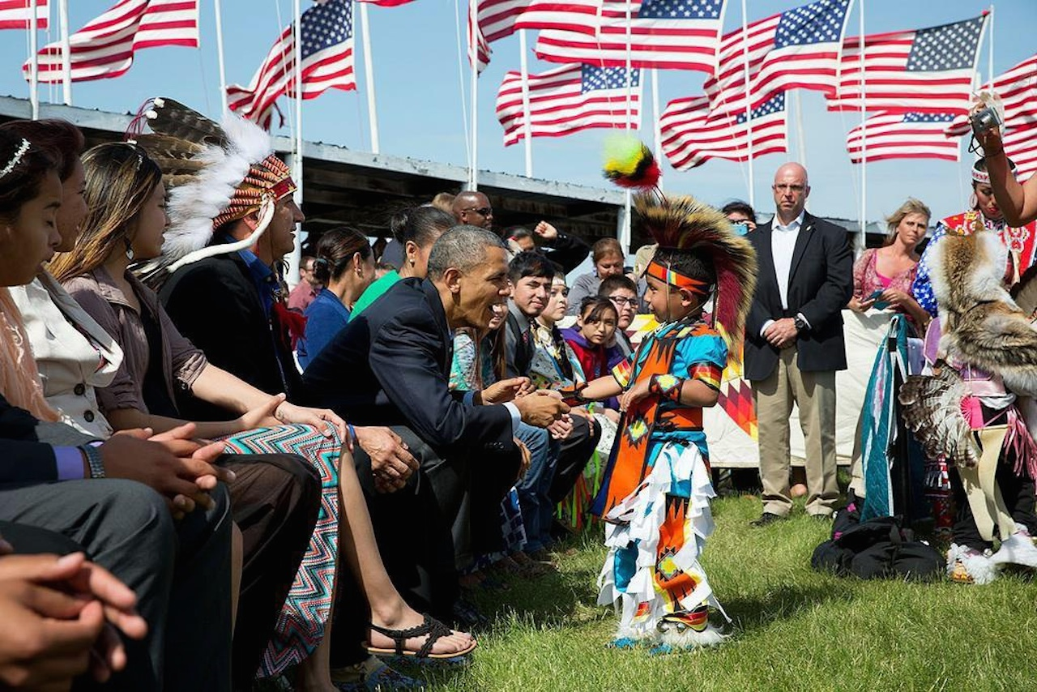
Resistance or acceptance?

Slide 22
Shannon Rivers
Contact:
Shannonk.rivers@gmail.com
(480) 220-6766
Facebook: Shannon Rivers

