Slide 1
Navigation & Negotiation of Fambamz on Facebook
Tuiloma Lina Samu
Massey University, SHORE & Whariki Research Centre
l.samu@massey.ac.nz/ ljvsamu@gmail.com

Slide 2
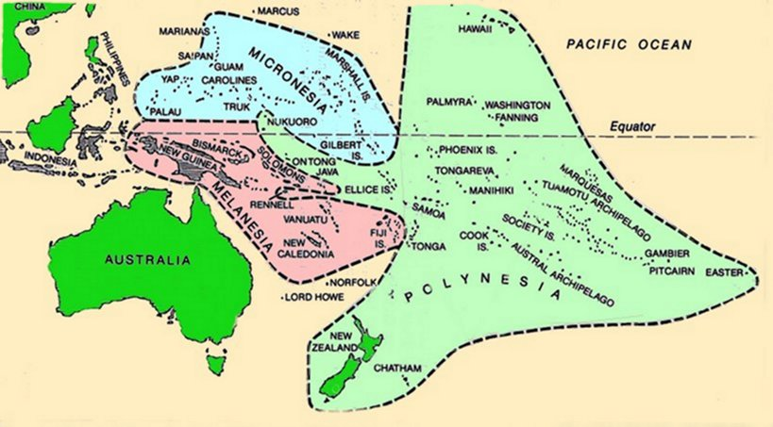
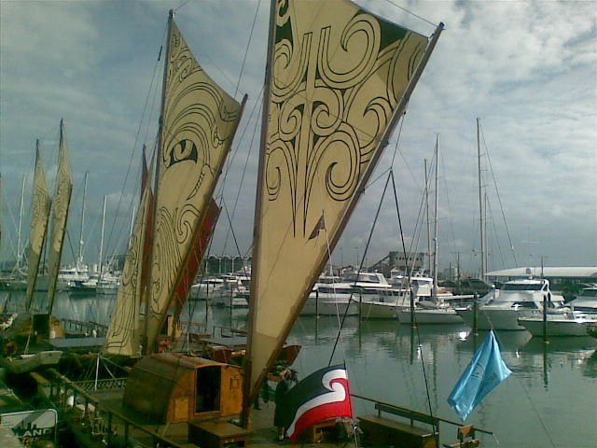
Notes:
Navigation emotively ties Pasifika people to our ancestors and to our Moana-nui-a-Kiwa cousins. That our ancestors are lauded as the greatest navigators on the planet evokes positive images that we come from people of courage, tenacity, high intelligence, skill and fearlessness! As other expedient modes of travel have replaced the need for sea travel and navigation – these ancient seafaring skills are being lost to us.

Slide 3
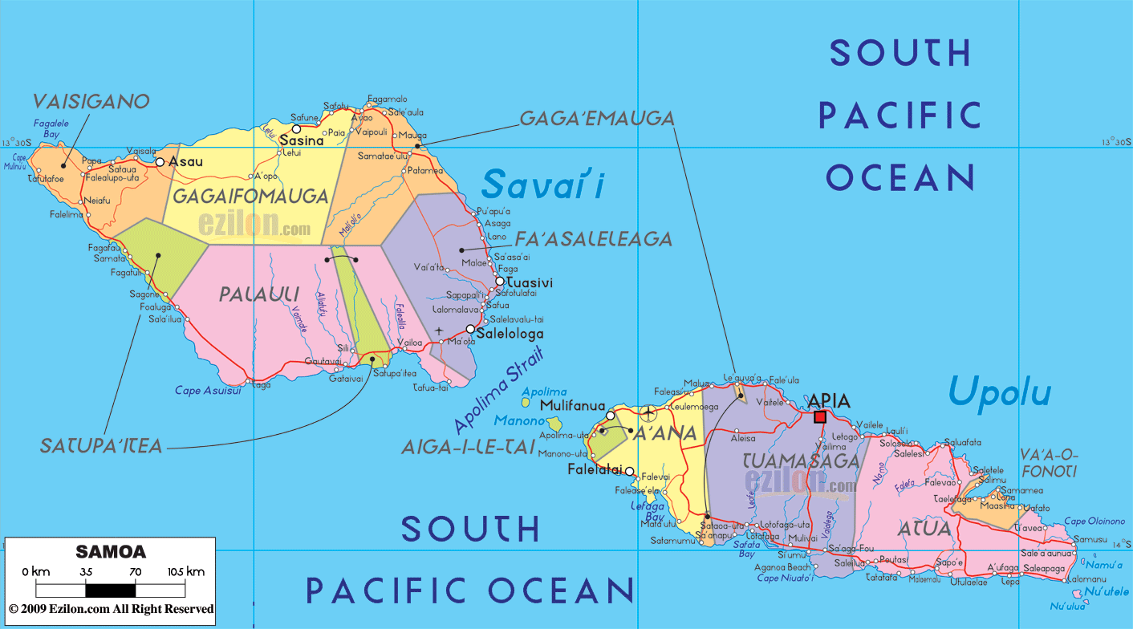

Slide 4
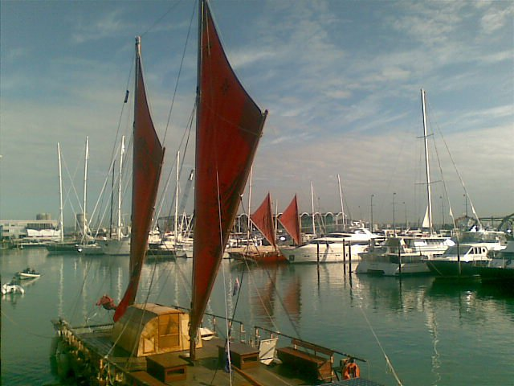
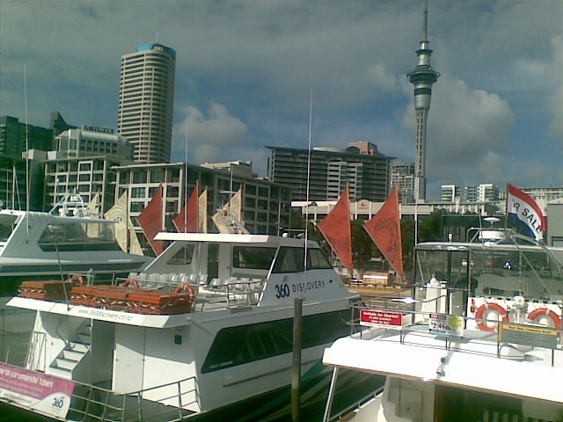
DIGITAL NAVIGATORS
Notes:
My research question is: How are social networking sites and online tools being used by young Pasifika adults in Aotearoa in their social lives and in identity creation/ formation?
More specifically the research will ask: 1. How do relationships and identity among young Pasifika adults play out in social networking cultures? 2. How are young Pasifika adults using social networking systems? 3. How social and cultural practices are being performed within the online virtual space and how this impacts on intergenerational expressions of identity and culture?

Slide 5



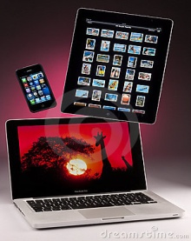

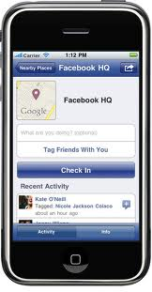

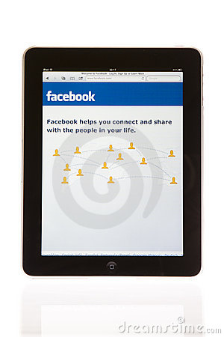
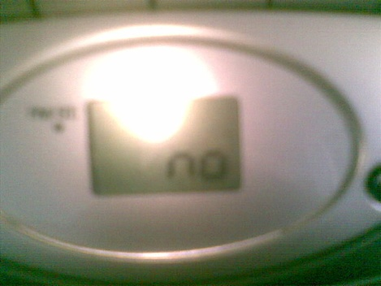
DIGITAL NAVIGATORS
Notes:
In this Century, these are the navigational tools for the generations known as “Digital Natives” or those who have been born in the age of the Internet, cellphone and new digital technologies. These younger generations are going on Facebook, on YouTube for connection and the Internet for navigation – “googling” online to find out information. Those of us who can a remember a time without these tools are called “Digital Immigrants” (Marc Prensky, 2001)

Slide 6
DIGITAL NAVIGATORS
Explore ways in which young Pasifika adults in Aotearoa New Zealand aged 18-25 are using new social technologies/ social networking sites especially Facebook in their social lives. How might they might be using these to help understand and/ or create their identities as Pasifika people.
How do relationships and identity among young Pasifika adults play out in social networking sites SNSs?
How are young Pasifika adults using social networking?
How are social and cultural practices being performed within the online virtual space and how this impacts on intergenerational expressions of identity and culture?

Slide 7
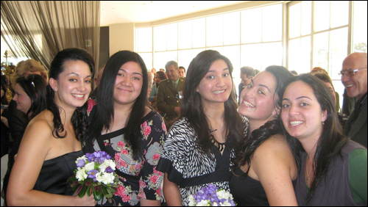
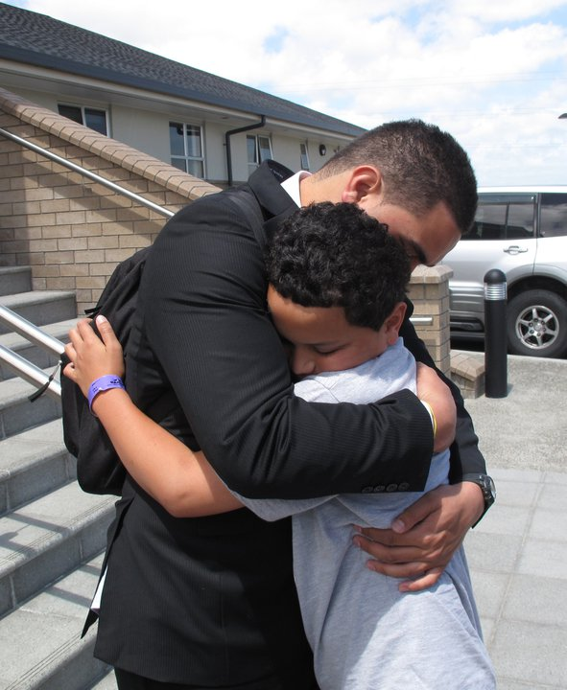
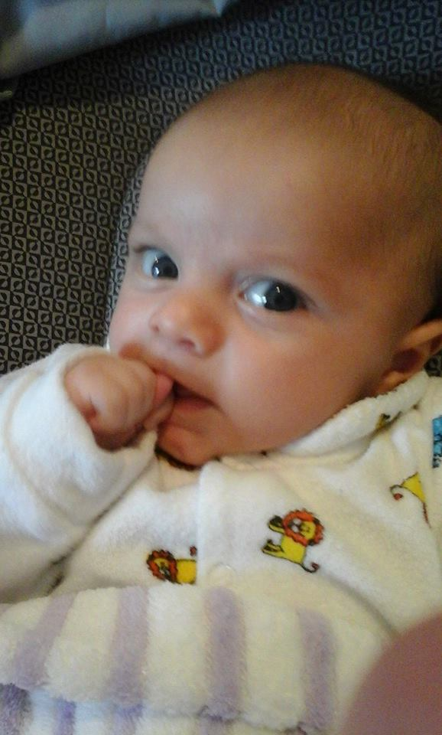
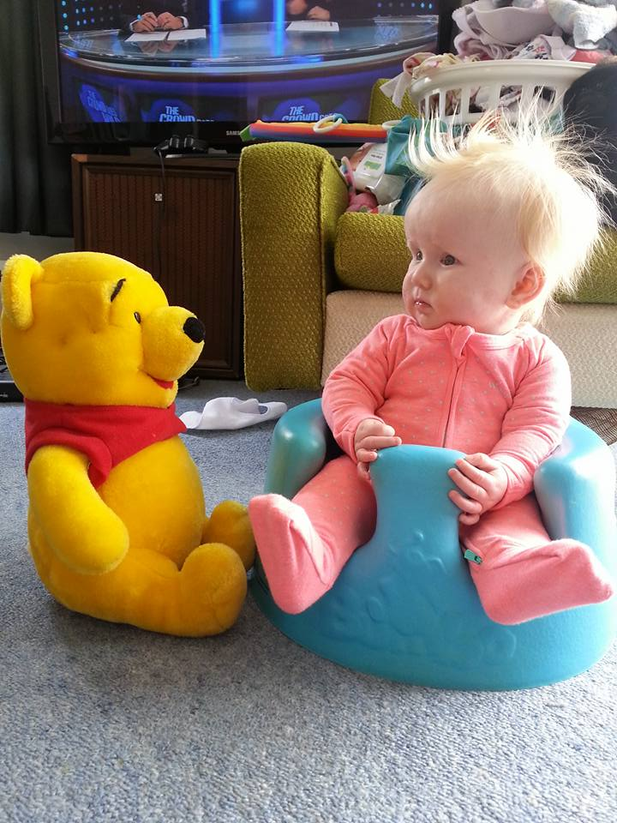
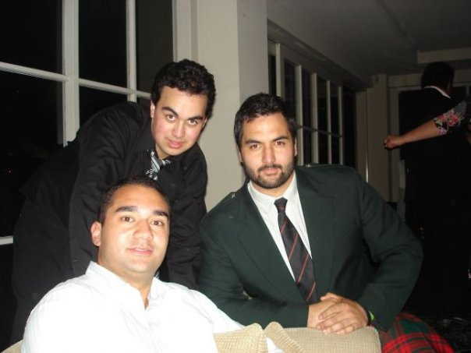
DIGITAL NAVIGATORS

Slide 8
Critical Trends Amongst Pasifika peoples Islanders in Aotearoa are changing fast!
• Two thirds of Pasifika are NZ-born (NZ Census 2013)
“That’s where I think we clash... my parents are like ‘we have to do this and this’ ‘cause that’s what it was like in Tonga. I’m New Zealand-born! I’ve never been to Tonga, so I refuse to live in that way”! Atamai, Fakaleiti, NZ-born Tongan, 22 years
•Growing number of Pacific people without religious affiliation
“And sometimes my parents make my siblings and I take out loans to feed the church and it’s like really? You’re doing this to like? My parents are definitely not scared of suffering for the church. They are definitely not afraid about that! ...We will SUFFER! We will live in hell for the church, that’s what our parents will make us do. If we have to, [Mum] will make us build a house in hell thank you, made out of stone, all for the church”!

Slide 9
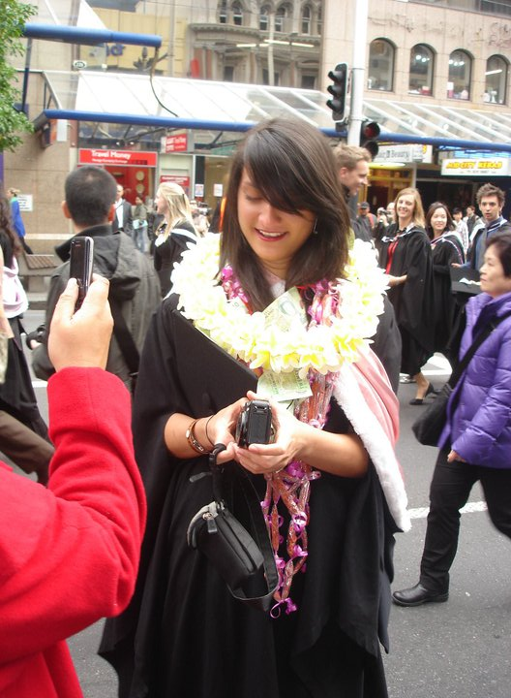
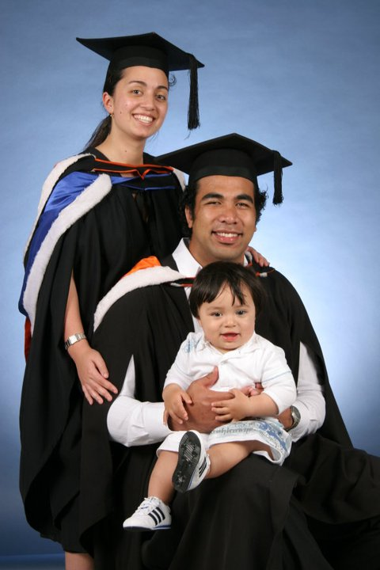
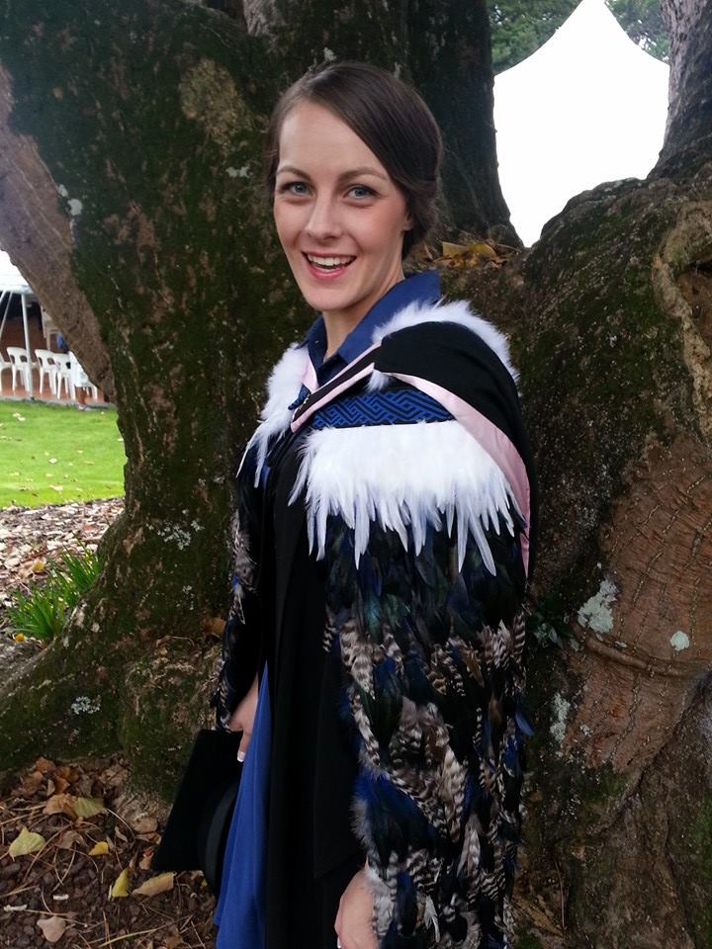
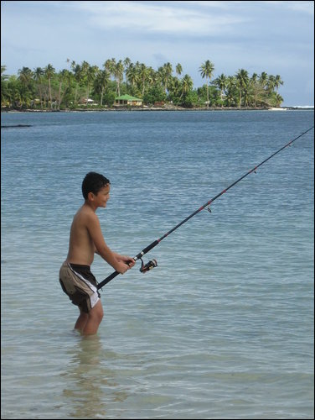
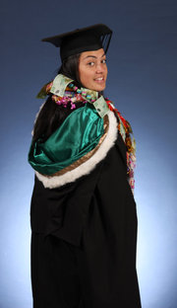
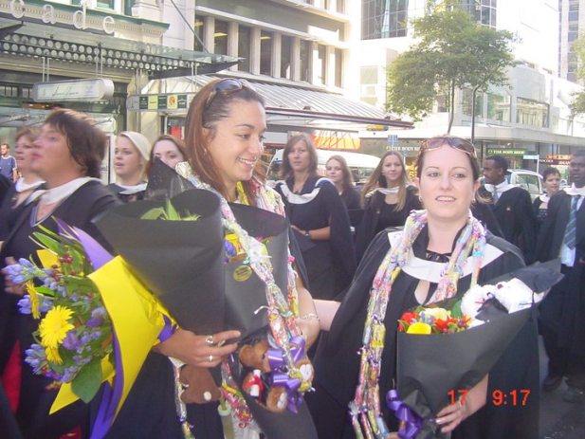
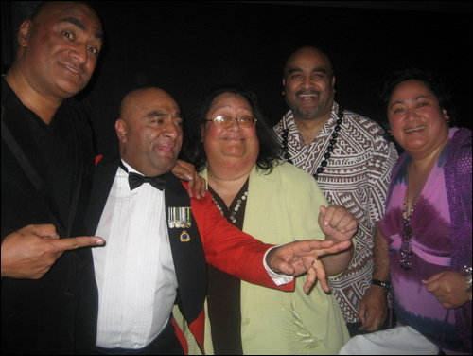

Slide 10
Severe Wealth Inequalities
60% of Pacific People have individual net economic wealth less than $16,000.
20% of Pacific People have an individual net economic wealth of less than $1,000.
Median personal incomes where Pasifika live in NZ
- 12% of Pasifika live in Wellington ($32,700)
- Just under 5% live in Canterbury/ Christchurch ($30,100)
- 66% of Pasifika live in Auckland ($29,600)
High demands on miniscule incomes
a’iga, kainga, magafaoa, ‘anau/ kopu tangata family
church/ religious obligations weekly, monthly, annually
- Cost of living versus income in New Zealand is high

Slide 11
Systemic Inequalities for Pasifika in NZ
•Pacific people are amongst the poorest/ least $$ wealthy population in New Zealand. Yet wealthy in social and community richness! Versatile and resourceful
•Economic inequality strongly correlates and causes other inequalities:
– Health High rates of diabetes and high needs interventions yet a general overall positivity amongst Pasifika
– Education Non-achievement yet multi-culturally fluent
– Housing Intergenerational living not merely overcrowding
– Citizenship participation Low voter turnout when uninspired
Pasifika peoples’ experiences in West Sydney are very comparable to Pasifika in South Auckland

Slide 12
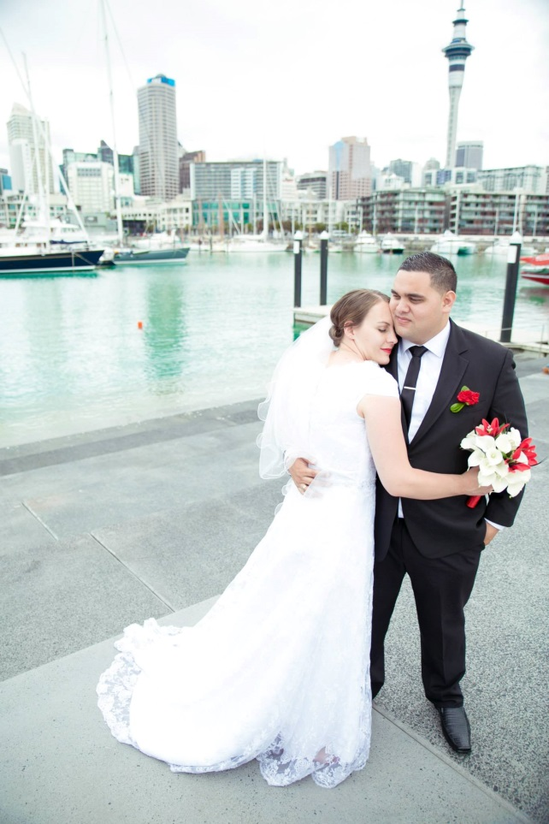
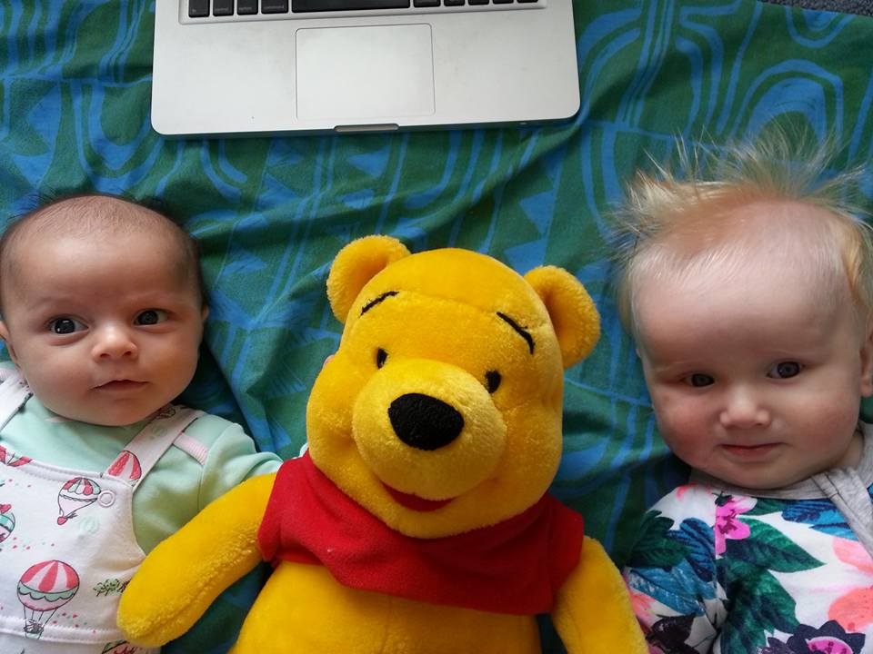
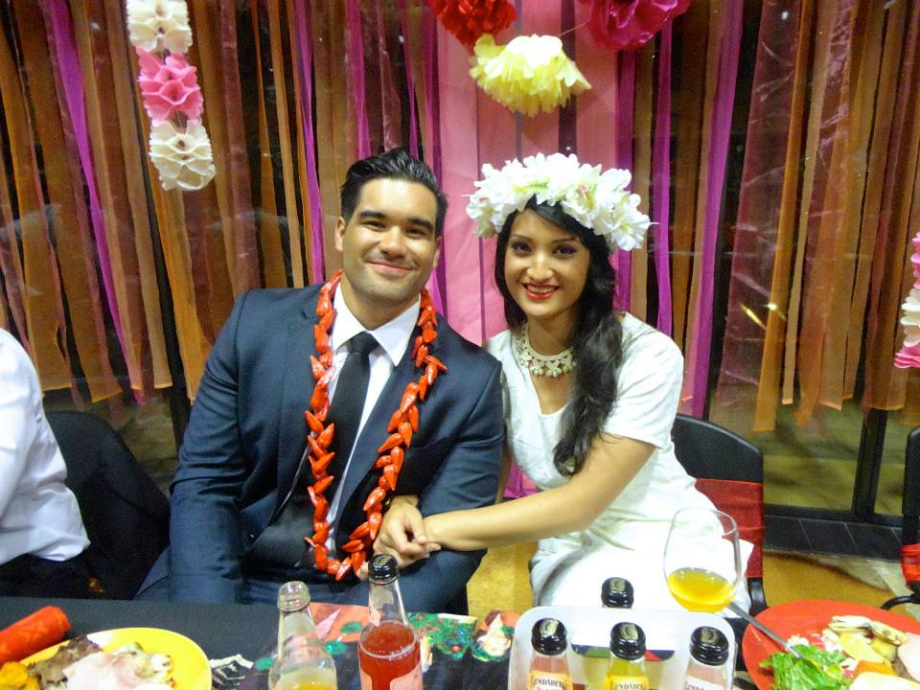
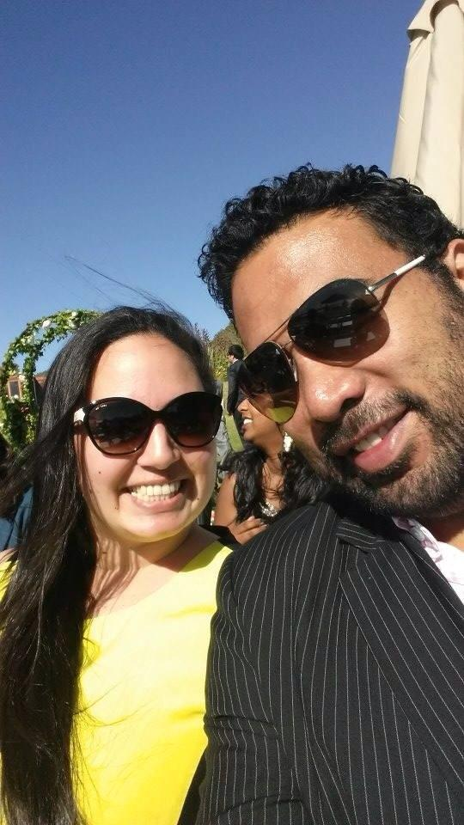
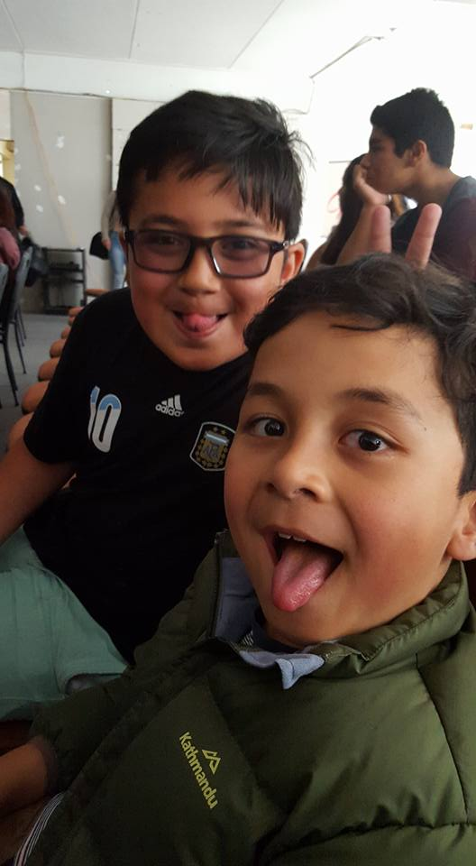

Slide 13
Critical Trends Amongst Pasifika peoples Islanders in Aotearoa are changing fast!
•The overwhelming majority of Pacific peoples in NZ have English as their first language
“If the parents or aunties and uncles don’t influence the kids in the house by speaking in Samoan and teaching or whatever Tongan or Niuean... the kids will lose that honour of having to speak and learn that language”
Jesse, Fa’afafine, Samoan-born Samoan, 21 years
Growing number of Pasifika people with multi-ethnicities but poorly measured in NZ
– e. g. Pasifika/European; Samoa/Tonga; Niue/ Maori; Tokelau/Cook Islands Maori/Chinese; Samoa/ Fiji/ Fiji Indian; Tuvalu/ Kiribati; Tahiti/ Pitcairn/ Hawai’i

Slide 14
Uniqueness to celebrate about Pasifika in Aotearoa NZ
We are very visible on the New Zealand landscape
There is much esteem identifying as Pasifika peoples.
The annual Pasifika Festival in Auckland every March is the most recognisable festival brand in Aotearoa
Tāmaki Makaurau/ Auckland has the highest Pasifika peoples population
Fa’afafine, ‘akavaine, fakafefine/ fakaleiti, fakafifine people are part of our culture and are valued and accepted
295,941 We are 7.5 % of NZ’s population (Maori 15%). Samoa, Cook Islands Maori, Tonga, Niue, Tokelau, Fiji, Tuvalu, Kiribati, Tahiti
Our population is young (22.1 years - NZ born 15 years; Maori 23.9 years median age)
Eighty percent still have a religious affiliation compared to 55% of New Zealand
“... the two most biggest roles in Pasifika life... no matter if you’re a Niuean, Tongan or Samoan, Fijian, you’d always have to put family first and you’d always have to put God first no matter what [Pasifika] ethnicity you are”
Penita. Fa’afine, Samoan-born , 19 years

Slide 15
Intergenerational Issues of Tension
Young people are marginalised in both Pasifika and Western NZ Pāpālagi cultures and contexts
So, Young Pasifika use social media to express their viewpoints and voice
Critical, critiquing yet mindful and respectful
“You can’t really be yourself on Facebook unless you kind of don’t care”. Kaleti, Tonga/ Samoa, Tongan-born male, 19 years

Slide 16
Features of our PhD study http://www.drinkingcultures.info/
Pasifika and Maori were more consciously alert about privacy and surveillance issues thus were more savvy about protecting themselves and being careful/ cautious on Facebook around posting statuses, photos, oversharing etc
Pasifika (and Maori) young adults were more likely to have family members as FB friends
Strong motivation to protect younger siblings and cousins
- Strong motivation to stay connected to loved ones around the world in Pacific Islands, Australia. the U. S, Hawai’i, Europe, Great Britain etc
Pressure to stay in contact with church members, community, some family, some colleagues, some acquaintances and old school friends

