Slide 1
Creating online chaos: A short guide
Celeste Liddle – Professional trouble-maker

Slide 2
Introduction to me and this session
Arrernte woman, born in Canberra, living in Melbourne
Unionist
Rantings of an Aboriginal Feminist
UniMelb and LTU graduate

Slide 3
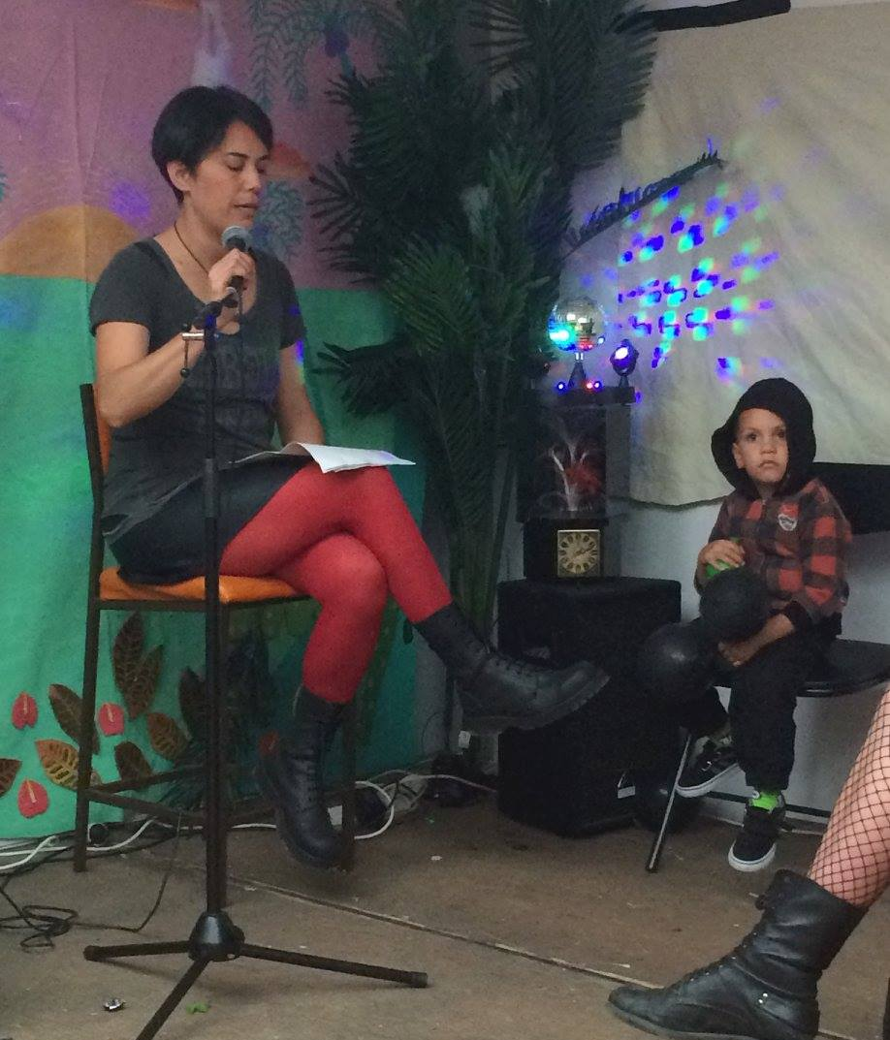

Slide 4
How did I “discover” social media?
Using forums back in my uni days
  Rudimentary online discussions
  Common interest places
Working in student support
Changing platforms and the ability to connect communities over vast distances quickly and in a way which was perceived more “personal”
Blogging as an anti-news space

Slide 5
Rantings of an Aboriginal Feminist – How it all began
The beginning of community activism on Facebook around misappropriation of history
Forming of online Aboriginal groups based around activism
Mentorship and encouragement
Identification of the “media issue”
  70% white dude control
  Where the media uses Indigenous voices, it is mainly the voices of Aboriginal men
  When this is not the case, the voices used tend to be conservative Aboriginal women
  Radical left Aboriginal feminist politics are therefore unlikely to be represented

Slide 6
What happened next?
Blog to freelance in six weeks
Freelance to public speaker almost as quickly
The increased presence of opinion blogs by Aboriginal and Torres Strait Islander people
The networking of these blogs and writers by groups such as Deadly Bloggers and IndigenousX
The permeation into the mainstream of diverse Indigenous opinion
The development of further online interfaces and networks (Indigenous, feminist, unionist)
BFR has now been going for 3.5 years – Averages around 2000 hits per piece

Slide 7
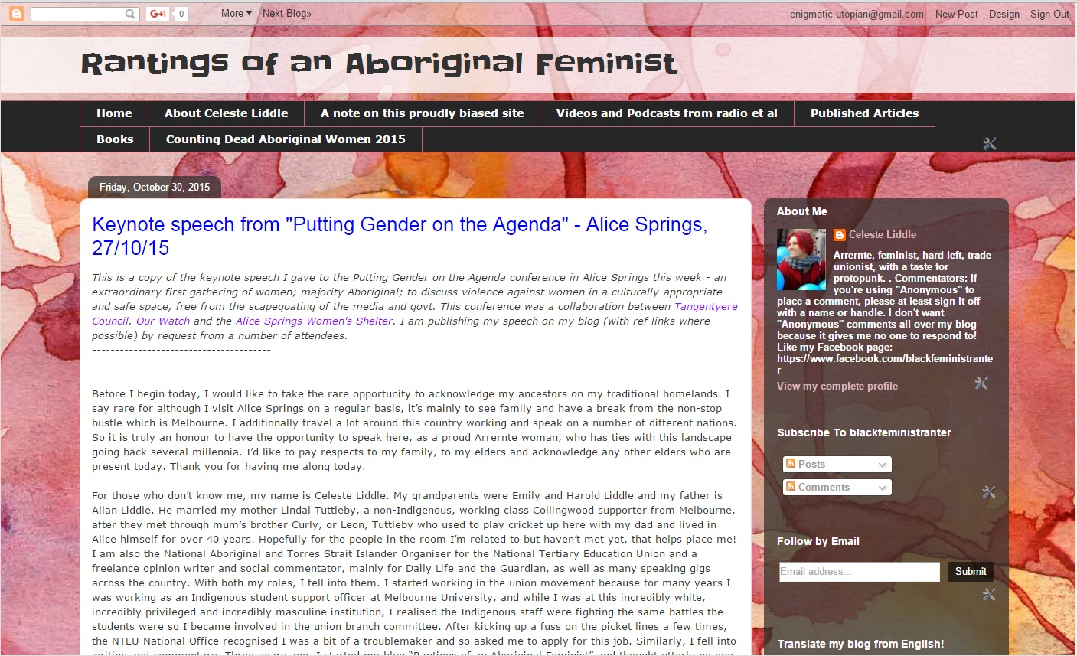

Slide 8
Campaigns from BFR:
Counting Dead Aboriginal Women
Gendered discussions of violence against Aboriginal women
Fundraising for ovarian cancer research
Uluru Bark Petition

Slide 9

Social media as a tool for troublemaking in the Union movement

Slide 10
To revisit earlier points quickly:
Online presence had already been established due to previous interphase with students
It was noted that many Aboriginal and Torres Strait Islander staff in universities had embraced social media as a way of not only connecting with the student body but also blogging and self-publishing
The NTEU Aboriginal and Torres Strait Islander social media accounts were the first ones to roll into existence in the NTEU and did so independently of the union
The NTEU developed social media policies later down the track as a response to the growing social media presence of the union, the need to maintain this presence in this day and age, and the developing of such communications of the broader movement.

Slide 11
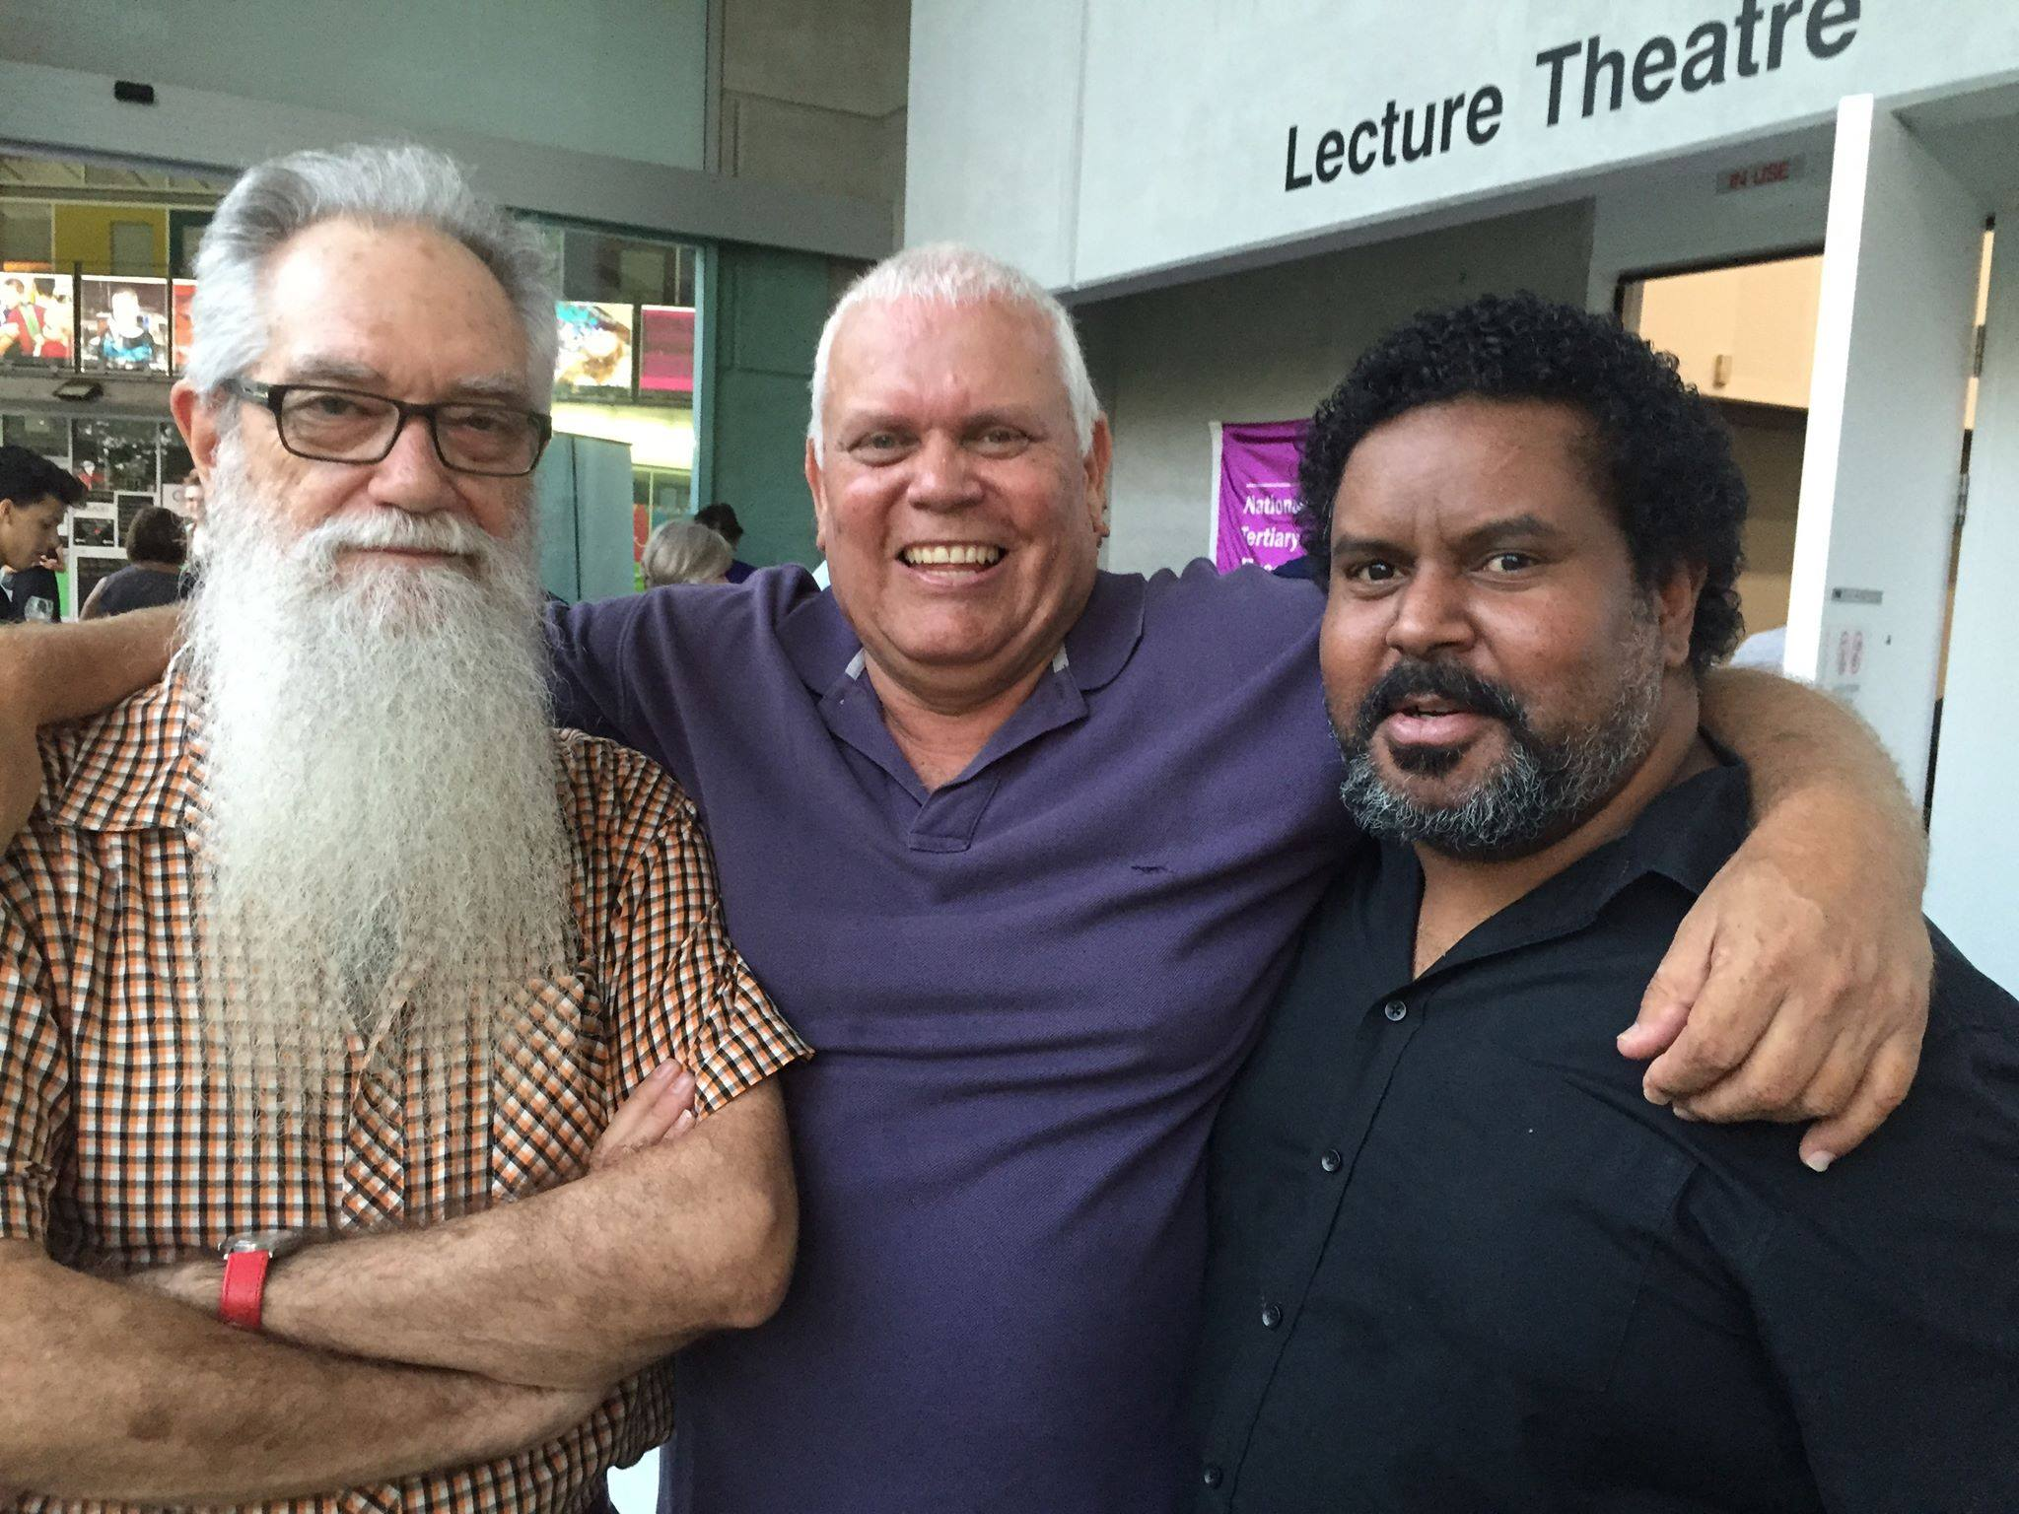
Some tactics

Slide 12
Tactics for online engagement:
The cult of personalities
  Many members and staff maintain their own activist presence on social media and there is an opportunity to cross promote and network, as well as humanise the activist space
  Many members and staff are active social commentators
Multi-modal communications
  Facebook and Twitter
  eYarn and email
  Print publications
Extend the relevance
  The broader engagement in social justice movements as a workers’ rights organisation

Slide 13
Examples of campaigns from the NTEU A&TSI which have been mainly fostered online
Racism, discrimination, cultural respect and lateral violence on campus
Mainstreaming agendas in universities
Alternate stances to Constitutional Recognition
Related stances on self-determination, sovereignty and treaty
Marriage equality and opposition to the Uluru Bark Petition
The push for Aboriginal and Torres Strait Islander employment targets

Slide 14
Outcomes from the A&TSI example
The NTEU has seen the importance of engaging online and has increased its presence as well as hired people specifically to undertake this work
The NTEU has increased its engagement with broader Aboriginal and Torres Strait Islander social justice campaigns (stop forced closures, as an example). It has additionally seen greater need for community connection
The National Aboriginal and Torres Strait Islander Organiser has twice acted in the position of social media co-ordinator for the NTEU on a National basis due to skills recognition and the need to boost daily interactions (not just increase activity during campaigns)
The NTEU has further developed a reputation for being a “dissenter” and has seen the benefit of having Aboriginal and Torres Strait Islander staff and members active in broader circles

Slide 15
Some links
Rantings of an Aboriginal Feminist: http://blackfeministranter.blogspot.com.au/
Black Feminist Ranter Facebook page: https://www.facebook.com/blackfeministranter/
NTEU Aboriginal and Torres Strait Islander Caucus Facebook page: https://www.facebook.com/IndigNTEU/
NTEU Aboriginal and Torres Strait Islander website: http://www.nteu.org.au/atsi
The twits: @Utopiana, @NTEU_Indigenous

